Slide 1


LinkedIn Job Analysis
PRESENTATION ON

Slide 2





Specifically a team project that is to be done multiple performs like :

Slide 3
It was a collaborative project
of four where every member contributed its best to make the project success.
Team Members-
1) Abhiraj S
2) Amrita Singh
3) Poulami Das
4) Mayur Lade

Slide 4
Final table
After web scraping and visualising it through sql
has these many columns:
company_id
details_id
job_id
company_name
title
industry
level
involvement
job -applicant
Count of job application
skills

Slide 5
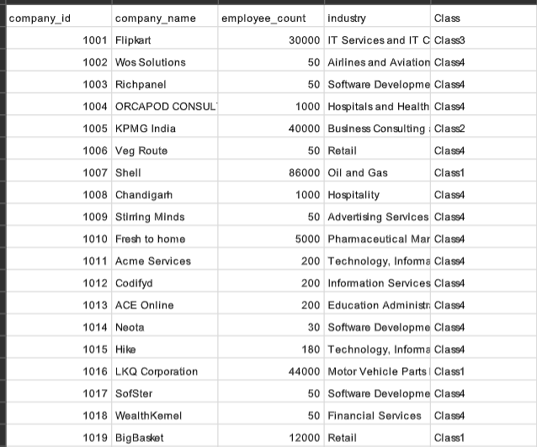
After scraping the LinkedIn webpage and analysing it through SQL, we classified the data into various classes:
Where classification is done on the basis of employee_count

Slide 6
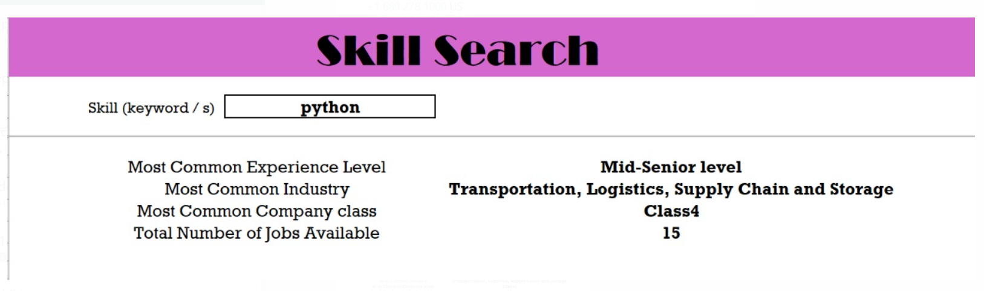
After classification, worked on dynamic search where user can easily search about his skills and get appropriate results which is mentioned below:

Slide 7
To reach up to this stage we connected the SQL Server database to Microsoft Excel which helped us to find the appropriate results.
This dashboard will help the user to get an insight about skills and all other relevant information like :
(If the user pursue the skill of python then that person can easily approach to industry like logistics, transportation which is class 4 and also the total number of job opening with that skill would be more than 15.)

Slide 8
Major Challenges:
Number of challenges that we faced during the project. Some of them are mentioned below:
Web scraping of skills and extracting only the relative technical skill.
Creating the web page that can filter the records on the basis of skill pursued by user.
And connecting all these things to database which can handle these changes.

Slide 9
Insights & Findings:
After all process we got one of the major insight is:
In today's era a person who is pursuing the career in technical field has major growth opportunity in comparison to those who are of non-technical background. And this can be easily seen on LinkedIn web page where highest number of job posted for technical field.

Slide 10


